Slide 1

Predicting NYC Auto Collision Volume
Team Information
Team Number: 45
Jeff Hedberg
Lisa Chille
Nick Cunningham
Brittany Lange
Delband Taha
Notes:
Thank you for viewing our final project presentation.
We are team number 45. Our team leader is Jeff Hedberg and our team members are Lisa Chille, Nick Cunningham, Brittany Lange, and Delband Taha.
Our project focus is predicting Auto Collision Volume in New York City for a local auto repair shop.

Slide 2
Project Background
While motor vehicle collisions have emotional, financial and health costs associated with them, they also present an opportunity to add/restore value in the form of auto repairs.
This project aims to help a fictitious local auto repair center in New York state, estimate the volume of incoming vehicles they can expect each year, assuming their market share¹ is known.
Notes:
Auto collisions, while sometimes unavoidable, are not something that is pleasant to be involved with.
When having to deal with this type of a situation, it’s nice to be able to work with an auto repair shop that has up front service Cost and Time estimates.
In order to help facilitate that process, we will be working for a fictitious auto repair shop in NYC and helping them forecast the expected monthly repair volume based on many previous years of data.
This should help them to better serve their customers.

Slide 3
Problem Statement - Nick
Primary
Use historic auto collision data from NYC to estimate the future collision volume.
Then, take these collision estimates and combine them with known market share of the fictitious auto repair business to forecast their expected auto repair volume.
Secondary
Recommend a targeted marketing campaign for market share growth, and then forecast gains
Evaluate the effect of COVID-19 on this industry sector.
Notes:
Our primary problem statement, as mentioned, is to estimate future collision volumes for the city of New York. Then using known market share, forecast repair volumes for our fictitious business.
We are also planning to explore secondary problems. First, use a targeted marketing campaign to forecast gains for specific customer groups by demographic data. And after that potentially exploring the effect of COVID-19 on the auto repair sector.

Slide 4
Literature review
Regev et. al. (2022)
Evaluated the crash risk of drivers of different ages and genders adjusting for travel exposure
Found that drivers between the ages of 21 and 29 carry the highest level of risk for being in a car crash contrary to popular belief
Impactful for our project since it grounded us and allowed us to let the data speak
Notes:
There are 3 pieces of research that were influential in our development of this project. I will introduce 2 of them in the next 2 slides, and then the final one in our COVID-19 discussion.
The first one is by Shirley Regev and their co-authors based in the UK (2022). They evaluated the crash risk of drivers of different ages and genders. On the surface, this work is very similar to work done by other researchers such as Lam (2002) in Australia and Williams (2003) in the US among others. The key innovation in Regev’s work however is adjusting for travel exposure. Regev and her co-authors (one of whom is a mathematician) devised a sophisticated formula for determining the total driving exposure of groups. With this formula in tow, they found that drivers between the ages of 21 and 29 carry the highest level of risk for being in a car crash. This goes against the status quo that has stood for over 20 years which stated that teenagers carry the highest crash risk among all age groups.
Even though we did not build on their specific models and formulae directly, it set us up for unbiased data analysis, since we were exposed to this contrasting view from the get-go. Throughout our project, we really let the data speak and worked hard to minimize the number of assumptions we made, even when the data spoke against our hypotheses.

Slide 5
Literature review (cont.)
He et. al. (2021)
Developed a technique using GPS data to predict where accidents happen.
Allow policymakers to create targeted solutions e.g., install traffic calming devices in areas that are predetermined to be risky.
We were inspired by the advanced models that they built.
Notes:
Developed a technique using GPS data to predict where accidents happen.
This work would allow policymakers to know where to focus their energies when working to improve the traffic situation in cities. While we did not build directly on their work, we were inspired by the advanced models that they built. This made us strive to build models that are very predictive of the problem at hand.

Slide 6
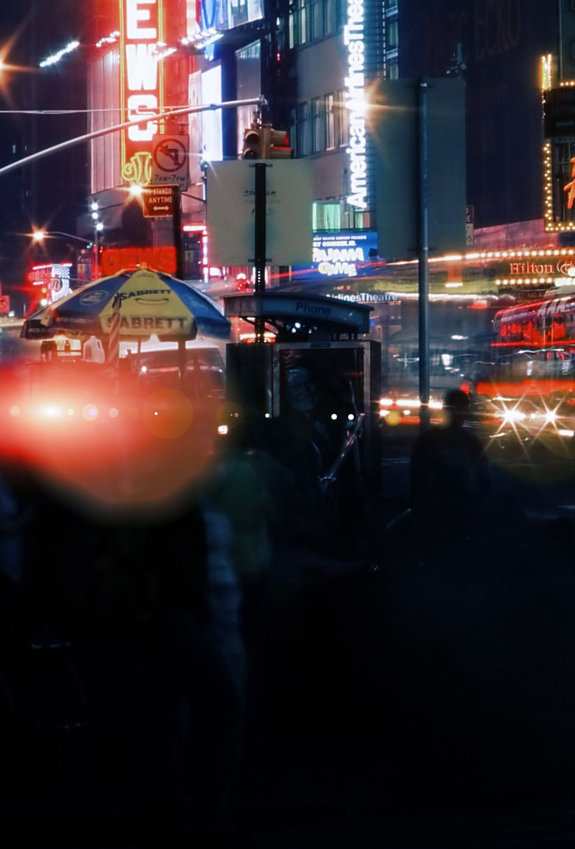

Data Sources
The main data sources for this project are sourced from data.gov. These data represent New York state vehicle collisions. We will be using data from 3 sources, which share common factors: COLLISION ID, UNIQUE ID, and VEHICLE ID.
The Crashes dataset contains data on the actual crash events in NYC from 2013-01-01 to 2021-12-31.
The vehicle dataset contains data on the actual crash vehicles in NYC from 2013-01-01 to 2021-12-31.
The person dataset contains data on the actual crash persons in NYC from 2013-01-01 to 2021-12-31.
Notes:
For our project we have 3 primary data sources that are publicly available from Data.Gov. The data represents vehicle collision data for New York City from 2013 through 2021.
The Crashes datasets contains the actual crash event data.
The Vehicle dataset contains data on the vehicles involved in the crash.
The Person dataset contains data on the persons involved in the crashes.
W are able to join these datasets using collision id, unique id, and vehicle id.

Slide 7
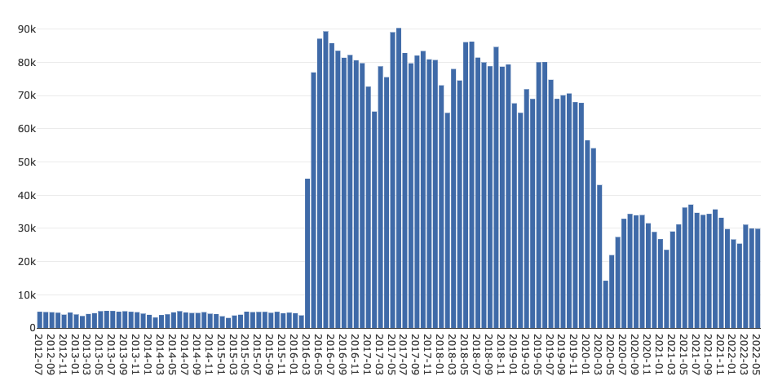
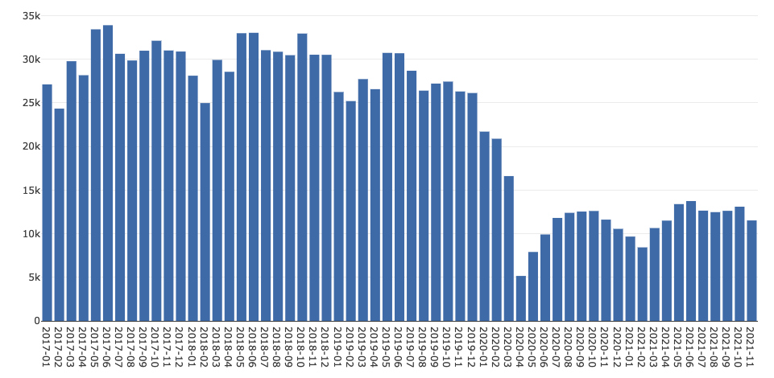
Known Issue
In our research, we discovered that as a result of a traffic safety initiative to eliminate traffic fatalities, the NYPD replaced its record management system with an electronic one, (FORMS), in 2016.*** We see this change reflected in the chart to the right. The amount of data collected from March 2016 on greatly surpasses the amount previously collected.
Resolution:
Because of this, and the fact that we want to help our local repair center forecast their yearly volume, we will use data collected after 2017-01-01 for full year modeling
Notes:
A known issue that we discovered with our chosen data sources were there is significantly less data available prior to 2016. In researching the cause, we discovered that s a result of a traffic safety initiative to eliminate traffic fatalities the New York Police Department replaced its record management system with an electronic one. Specifically, this change took effect March 2016.
Since we are planning to forecast yearly volumes, we decided to use data collected January 1, 2017 onwards. As you can see in the bottom right graph.

Slide 8
Approach
Prediction
Use model to estimate demand for local shop * market share
Testing
Compute expected car crash count on test data using best model
FINAL
Training/Validation
Cross-Validate/Train using different models, select based on R² or MAE
STEP 4
Feature Selection
STEP 3
Use identified key predictors, experiment w/ LASSO elastic net for auto feature selection
STEP 2
Data Wrangling
Join datasets, engineer synthetic features
STEP 1
Notes:
Our approach in this project is follow a fairly standard Data Science work flow.
Step 1 Data Wrangling - We will join the datasets and engineer synthetic features
Step 2 Feature Selection – Start with identified key predictors, and then experiment with auto feature selection techniques
Step 3 Training and Validation – We will cross validate and train different models and select the best based on R squared values or Mean Absolute Error
Step 4 Testing – Using the best model we can then compute expected car crash volume on our test data
Prediction – Use our model to estimate demand for the local shop and multiple this by market share

Slide 9
Hypotheses
1. Be able to estimate the monthly demand for a fictitious auto shop in New York state by extrapolating the monthly car crash volume with reasonable accuracy.
2. Identify a demographic that comprises the largest market segment for motor vehicle repairs after an accident; from our preliminary investigation, we suspect that young men comprise this demographic.
3. Be able to assert that $x expenditure on advertising targeted towards the most valuable demographic will result in $x+y revenue.
4. Be able to quantify the impact of COVID-19 on demand in this sector. Our preliminary investigation has already highlighted this.
Notes:
We have some specific hypotheses that we are looking to prove or disprove through our project.
We will be able to estimate the month demand with reasonable accuracy
We will be able to identify a demographic group that comprises the largest market segment for motor vehicle repairs. Our first guess is that this group is young men.
We will be able to assert that dollars spent on advertising towards the most valuable demographic(s) will results in a justifiable increase in revenue
We will be able to quantify the impact of Covid 19 on demand in the auto repair sector. We can see from initial data discrovery that volumes did in fact drop during the covid shutdown.

Slide 10
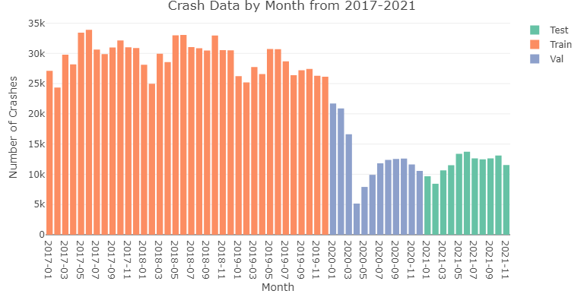
Data Partitioning and Modeling Steps
Time-aware Modeling required chronological partitioning
Initial Models / Hyperparameter Tuning
Training – 2017-01 to 2019-12
Validation – 2020-01 to 2020-12
Models Rebuilt on Train + Validation
Training + Validation - 2017-01 to 2020-12
Test set left aside for Final evaluation
Notes:
Since we are using time-aware modeling approaches, it’s necessary to have chronological partitioning for training, validation, and test sets.
For model building we have trained and validated on the data from 2017-2020
The test data set (2021 year) has been left aside for Final evaluation.

Slide 11
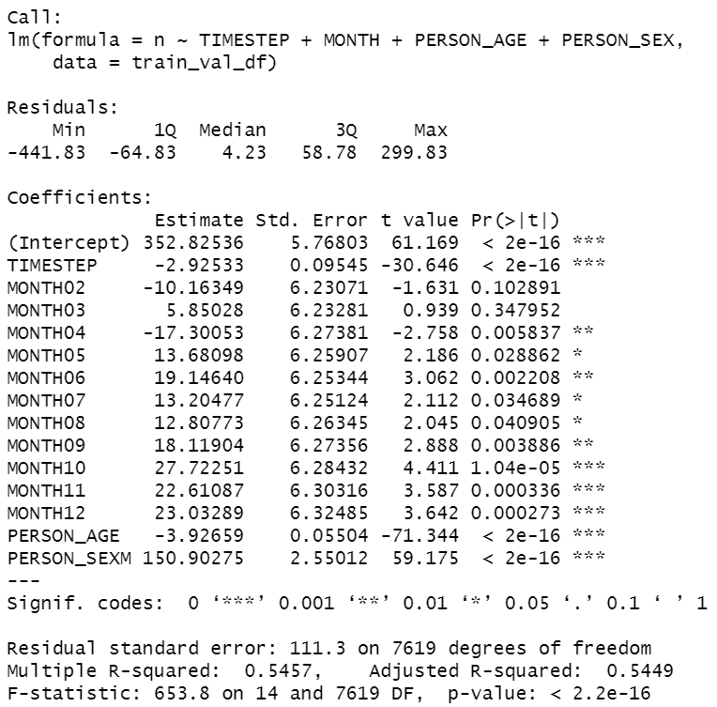
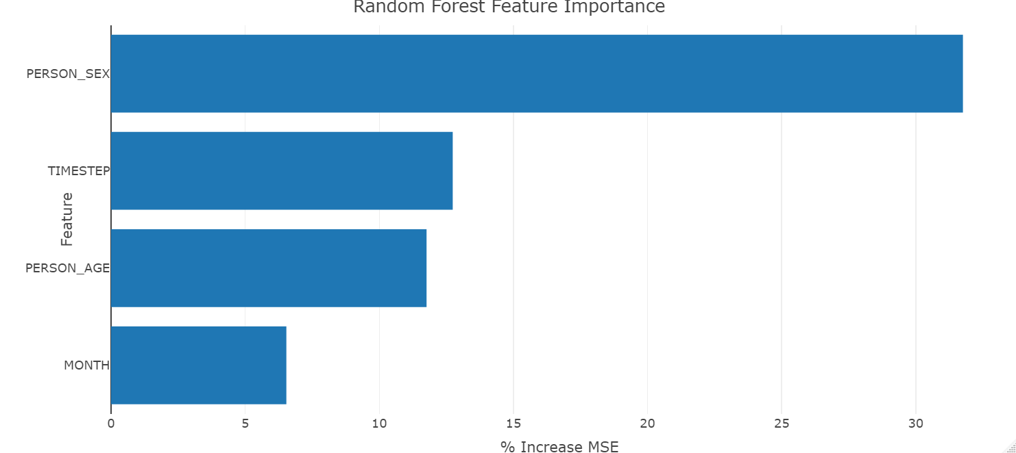
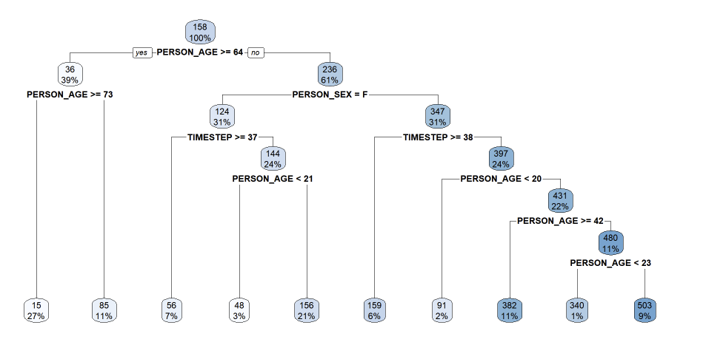
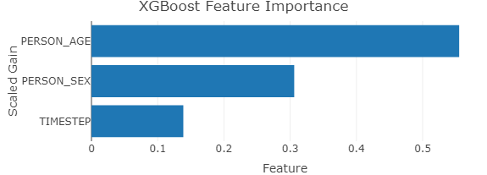
Model Evaluation Overview
Linear Model
Random Forest model
Models Explored:
Multiple Linear Regression
Random Forest
Classification and Regression Trees
Extreme Gradient Boosted Trees
Ensemble of models above
CART Model
XGB Model
Notes:
We explored models for Multiple Linear Regression, Random Forest, and Classification and Regression Trees, Extreme Gradient Boosted Trees and an Ensemble of all types.
As discussed on the last slide, these models were had hyper parameters tuned using the Training and Validation partitions.
After this was completed, they were re-trained on the Training + Validation partitions.
Error metrics for these models will be reported in future slides.

Slide 12
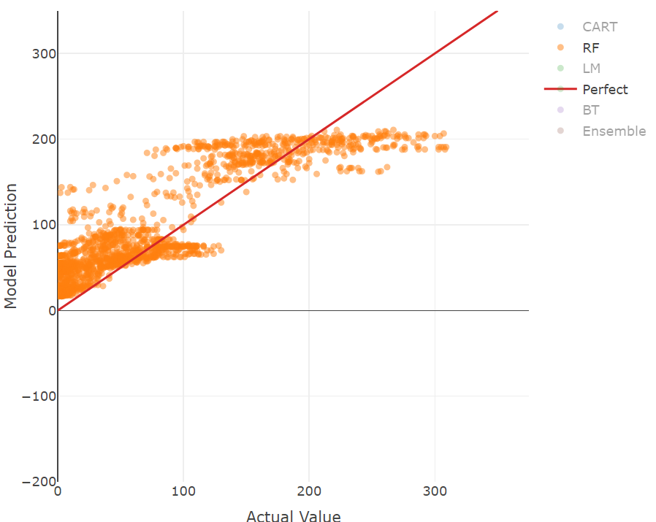
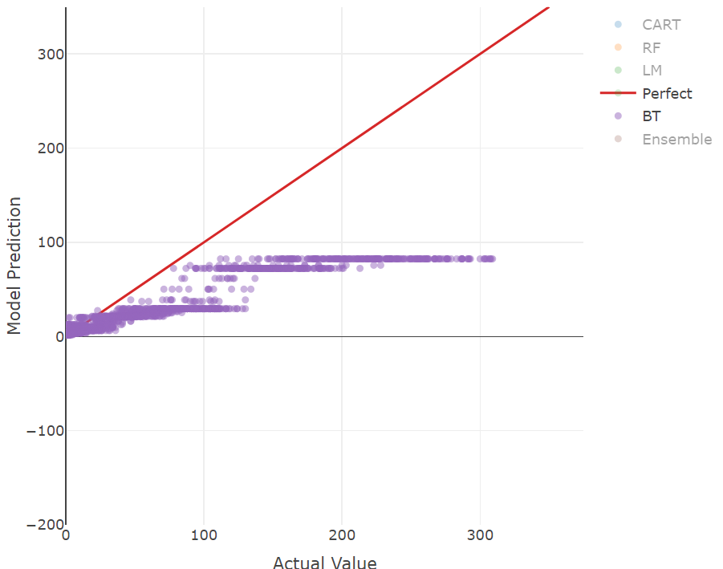
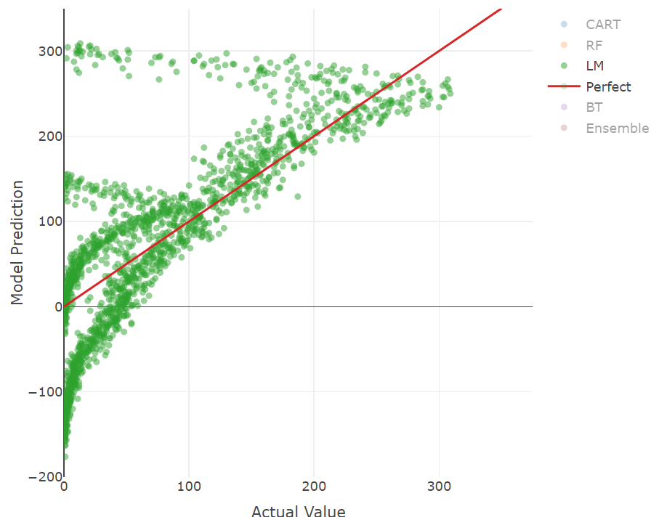
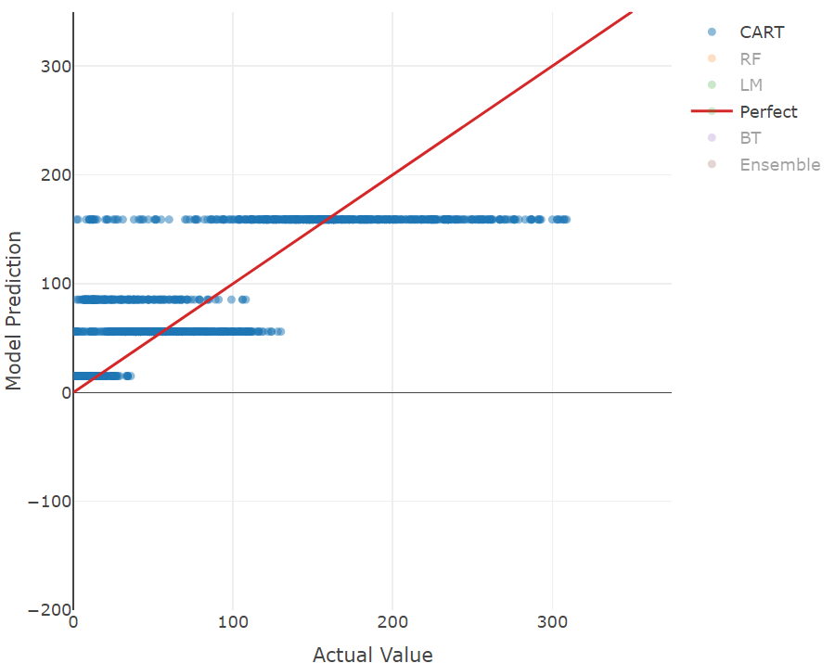
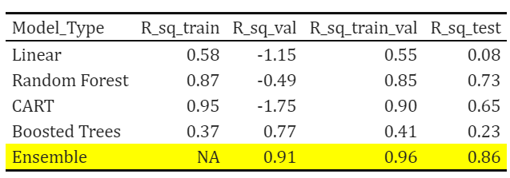
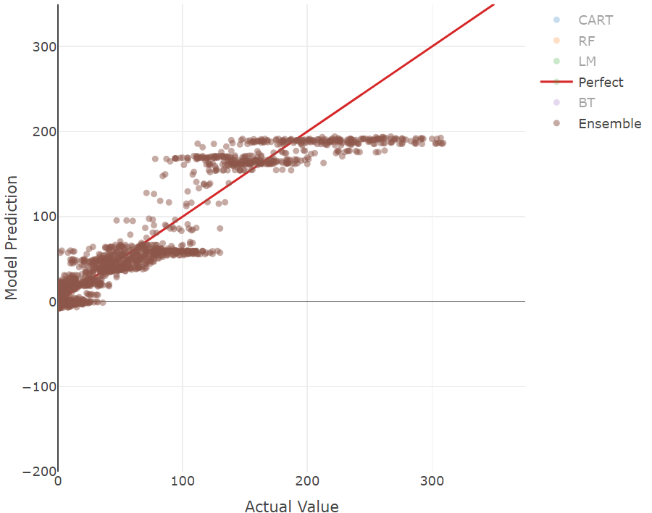
Modeling Results
Random Forest
Boosted Trees
CART
Multiple Linear
Ensemble
Notes:
After extensive modeling, the Ensemble we developed performed the best on Validation, Training +Validation, and Test datasets.
You can see how the different model stack up via the table on the left, or the plots on the right.
The plots on the right are Model Prediction vs Actual values, so you would expect a perfect model to be on the red line shown.
This view helps when comparing residuals across many different model types.
Notice how well the Ensemble performs compared to the individual models.

Slide 13
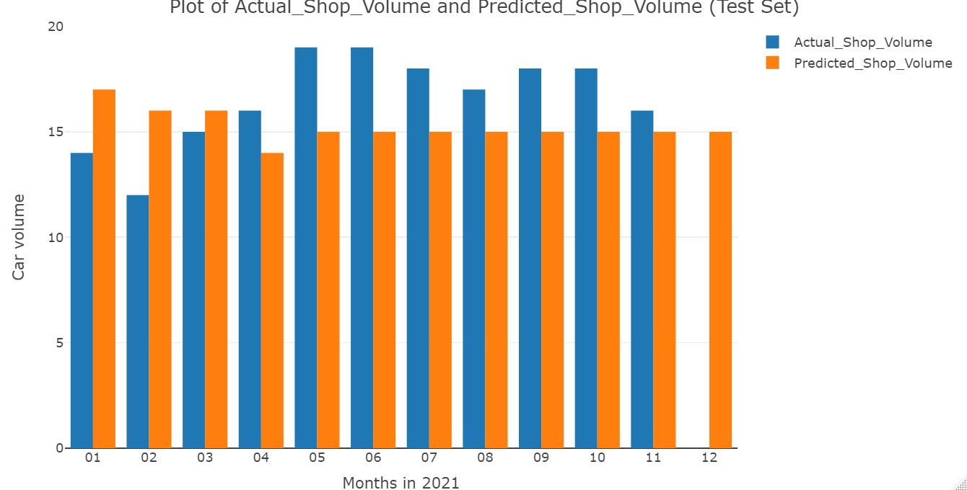
Ensemble Model Output
Model performs very well
We hypothesize that the model would be even better with out the impact of COVID-19.
Next, we’ll discuss secondary research objectives for our project.
Notes:
Predictions from our Ensemble model can be seen in the plot on the right.
The Actual Volume is colored Blue, and the Predicted Volume is colored Orange.
As you can see, we developed an ensemble model that performs very well.
Next, we’ll discuss the secondary research topics we had for this project.

Slide 14
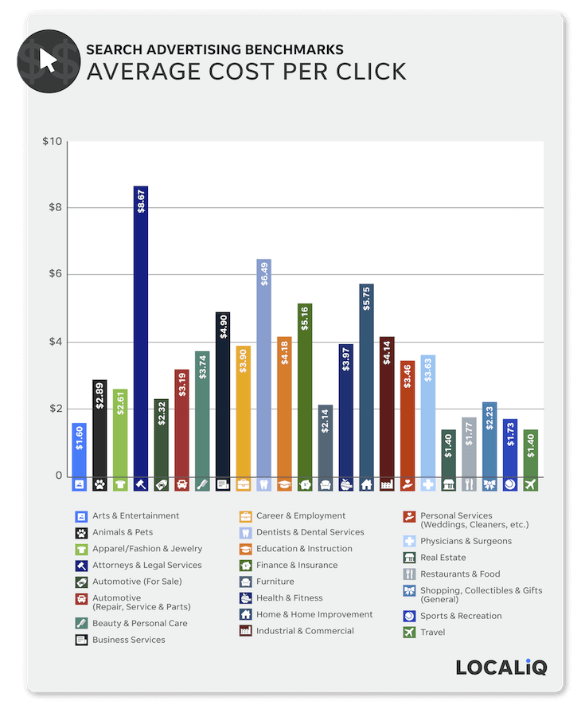
Secondary Problem Statement: Marketing Campaign
Recommend a targeted marketing campaign for market share growth, and then forecast gains
2021 Paid Search Industry Benchmarks
Automotive — Repair, Service & Parts
CTR | 5.39%
CPC | $3.19
Conversion Rate | 15.23%
Cost-per-Lead | $17.81
Notes:
For our Secondary Problem Statement we explored creating a Google Adwords Marketing Campaign that targeted consumers searching for collision repair.
To simplify we sourced recent paid search benchmarks for the automotive repair industry. While this doesn't give us perfect market and industry alignment it does show that compared to other industries, auto repair has a relatively high cost per click but also a high conversion rate.
CPC of $3.19 and a conversion rate of 15.23% were the primary KPIs we used. We assumed 15% of ad clicks converted to a new customer. So a cost per conversion was $21

Slide 15
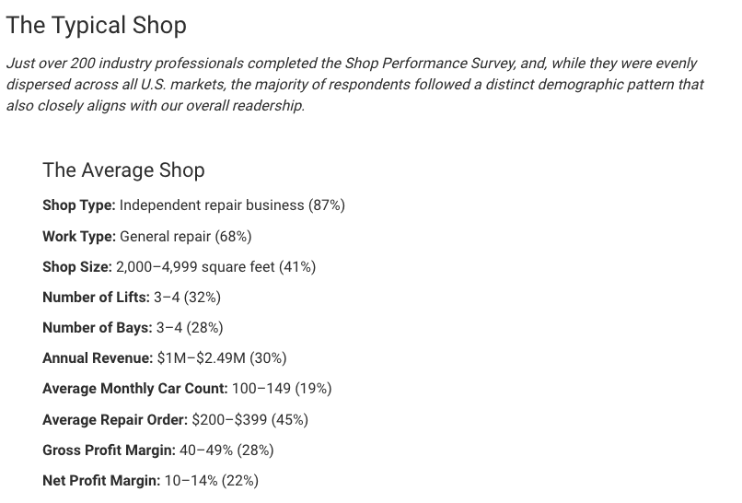
Marketing Campaign – Financials
In-order-to build out a costing model of shop performance, we sourced average financial metrics from an industry publication. We adjusted the ARO to $2400 to account for collisions being a higher cost service.
Average Repair Shop Financial Metrics
Average Repair Order (Units) | $2,400
Gross Profit | 40%
Net Profit Margin | 10%
Notes:
To create a costing model of our campaign we used an industry publication that surveyed auto repair shop owners to find average volume and performance metrics.
Given that this is a survey of auto repair shops not just collision repair, we decided to increase the Average Repair Order to $2400 since collision repair is a significantly more costly service on average.
We also used the low end average of Gross Profit and Net Profit. For the Profit Margins we are assuming a static % that accounts for all costs to run the business and that costs like labor and parts stay the same as volume in creases. In reality costs are something that a shop would have to tightly control and would be a significant driver in success. As volumes increase, the shop owner could negotiate price discounts on parts, etc. Labor $s on the other hand would be fairly stable, but would increase over time.

Slide 16
Marketing Campaign - Performance
 | Search Ad Spend
Campaign KPIs | $200 | $300 | $400
Clicks | 63 | 94 | 125
Conversion | 10 | 14 | 19
Revenue | $22,916.61 | $34,374.92 | $45,833.23
ROAS | 114.58 | 114.58 | 114.58
Market Share Lift | 0.0006 | 0.0009 | 0.0012
Gross Profit | $9,166.65 | $13,749.97 | $18,333.29
Net Profit | $2,291.66 | $3,437.49 | $4,583.32
ROI | 1146% | 1146% | 1146%
Assumes cost/unit static w/ increase (labor + parts)
Using the Industry Search Benchmarks and Financial metrics we were able to cost out performance of three different Search Ad Spends.
If we have a Market Share Goal of reaching 25 basis points, we can see that a $300 monthly ad campaign gets closest to achieving this.
Notes:
For our project, we assumed that the auto repair shop has a market share of 14 basis points. We also set a goal of increasing our share to about 25 basis points. Using the industry’s search advertisement benchmarks provided by Local-IQ, we estimated the performance of three advertising spend amounts. We used budgets of 2, 3, and 400 for search advertising.
Remember from the previous slides that the auto repair industry has a click-through rate of 5.39% and conversion rate of about 15%. Based on the benchmarks and our calculations, it looks like spending $300 on advertising will generate about $14K additional revenue from 14 new customers.
Please note that return on advertising spend and ROI did not change at around 115 and 1146 respectively. That is due to the fact that we are assuming a static cost/unit when we gain additional new business generated from digital advertising.

Slide 17
Secondary Problem Statement: Effect of COVID-19
First reported case of COVID-19 in New York state on March 1, 2020, but as many as 10,700 New Yorkers had already contracted the virus
March 9: 16 cases in NYC alone
March 16: public schools close, beginning COVID-19 lockdown
Stay-at-home orders in place until June 8, when phase 1 of reopening began under safety protocols
Estimated 44% of all metro NY residents infected by end of 2020
Total of 25,000 confirmed deaths of NY citizens with 5,000 probable
Notes:
Another secondary problem statement we are interested in is the effect of COVID-19 on motor collisions in NYC. The first reported case of COVID-19 was confirmed in New York on March 1, 2020, while researchers later estimated as many as 10,700 New Yorkers had already contracted the virus. By March 9, there were 16 confirmed cases in NYC alone and on March 16, public schools were closed, effectively beginning the COVID-19 lockdown. This remained in effect until June 8, when the governor announced the first phase of reopening under safety protocols. By the end of 2020, researchers estimate that 44% of all metro New York residents had been infected. To date, over 35,000 deaths of New York citizens have been attributed to COVID-19, with at least another 5,000 listed as probable deaths.

Slide 18
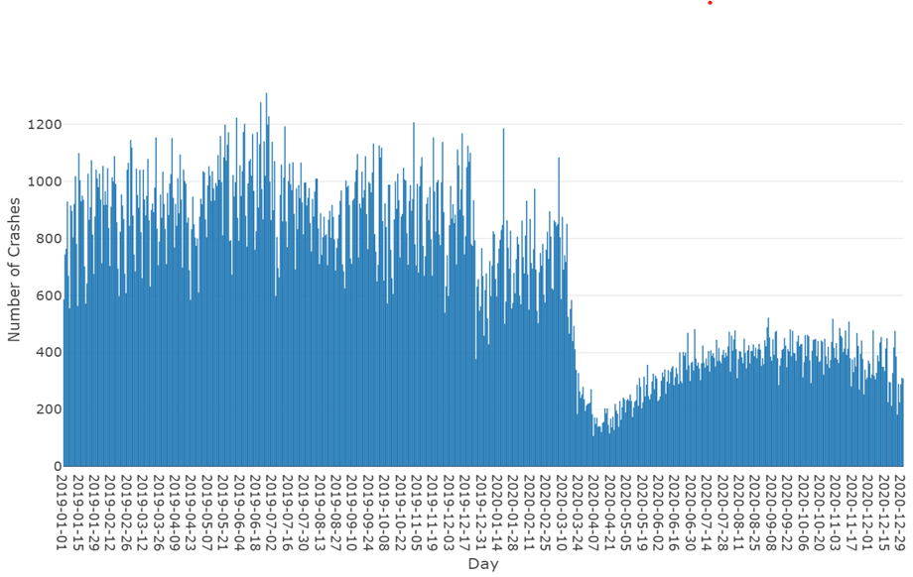
NYC Vehicle Collision Data by Day
Notes:
A closer look at the number of daily car collisions in NYC beginning in 2019 through 2020 shows a significant drop in crashes per day starting in the middle of March and continuing throughout the rest of 2020.

Slide 19
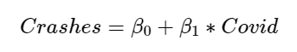
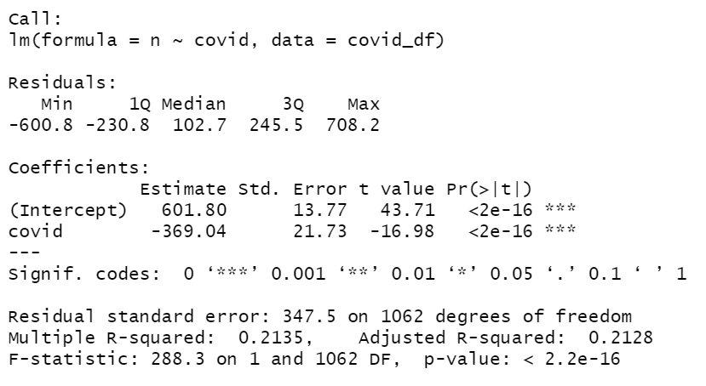
Regression Analysis
Using COVID as an indicator variable and the number of daily crashes in NYC as the response variable, we built a linear regression model to analyze the effect of COVID-19 on vehicle collisions in NYC.
Our findings suggest that before Covid, there was an average of 602 crashes a day in NYC. This number dropped to 233 crashes a day after Covid.
NYC safer-at-home policies led to a 61.3% reduction in vehicular collisions
Notes:
We set out to analyze the effect of the pandemic on NYC collisions from 2019 through the end of 2020, marking the NYC stay-at-home orders on March 16 as the beginning of Covid.
Our model shows a large and significant drop in the number of average daily vehicle collisions in NYC, from 602 to 233, leading to a decrease in crashes by 61.3%

Slide 20
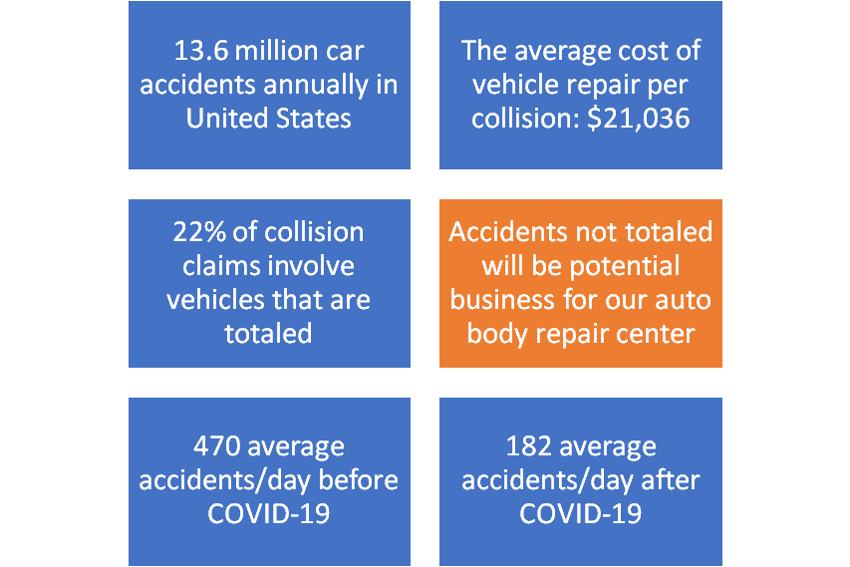
Decrease in Costs Due to Accidents
Notes:
According to the National Highway Traffic Safety Administration from the US Department of Transportation, there are 13.6 million vehicle collisions each year in the United State and the average cost of vehicle repair per collision is $21,036. Our research also indicates that 22 percent of collision claims involve vehicles that are totaled. We assume that accidents not totaled will be potential business for our auto body repair center. We then conclude that the average accidents a day, removing totaled collisions, from 2019 though the beginning of COVID-19 is 470, while the average accidents a day after COVID-19 through the end of 2020 is 182.

Slide 21
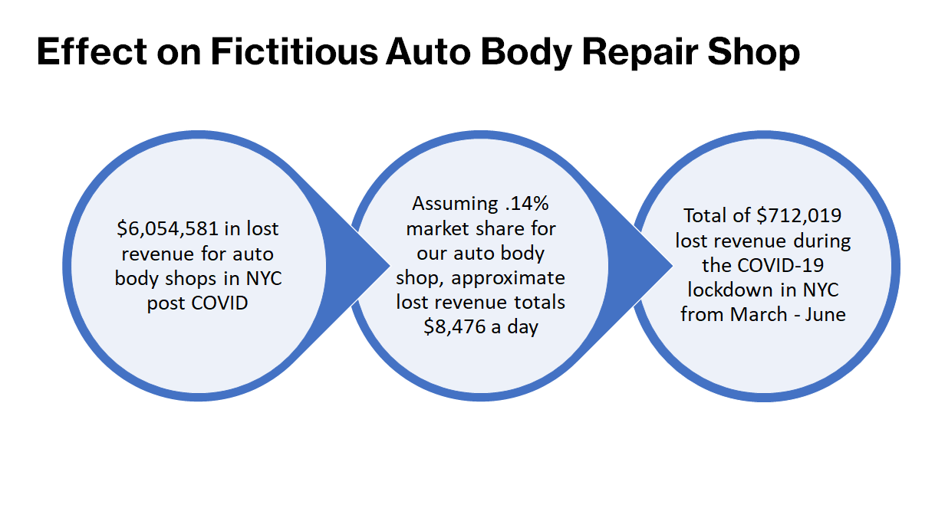
Notes:
We estimate over 6 million dollars in lost revenue for auto body shops in NYC post COVID. Assuming .14% market share for our fictitious auto body shop, lost revenue totals 8 and a half thousand dollars a day. Furthurmore, we estimate the total revenue lost during the COVID-19 lockdown in NYC from March - June 2020 is $712,019.

Slide 22
Literature review (cont.)
Li and Zhao (2022)
Quantity of vehicular collisions has plummeted, but cyclists’ fatalities have tripled since the start of the pandemic.
Cycling kilometers increased by 150% in Philadephia.
Collisions tend to happen in temporal and spatial hot zones.
Notes:
As my colleague Brittany explains, the number of car collisions in NYC fell drastically from 602 to 233 pre- to during the pandemic, respectively. Despite this however, the rate of fatalities among cyclists involved in traffic collisions have tripled per Li and Zhao in their 2022 paper.
It is important to note that cycling kilometres increased by about 150% in some cities such as Philadelphia. This might explain the increased fatalities among cyclists in traffic collisions.
Li and Zhao identified temporal and spatial hot zones where collisions involving cyclists most likely occur. This makes it possible to deploy policy changes to address this problem.

Slide 23
Future work
Understand differences between traffic collisions that involve cyclists and those that do not.
Determine features of vehicular and cycling collision hot spots.
Use the sophisticated formulae for traffic exposure from Regev et. al. (133) on new data sets to see if it applies in other places.
Perform more data exploration through advanced visualizations to pull out and analyze any other trends in the data.
Notes:
Li and Zhao's work served as fodder for us to consider how we would expand this work further. The relationship they uncovered between cyclists' fatalities and COVID-19 is certainly worthy of further exploration. On that same vein, it would be worthwhile to use GPS or other location data to uncover where car and cycling collisions happen the most respectively. Perhaps roundabouts cause the most confusion for cyclists with fatal outcomes. Or maybe it's hills. This is worth investigating.
Further, we could build upon Regev’s team’s work by using the sophisticated formula they propose on page 133 of their paper. This could allow us uncover additional insights in our data.
And finally, we could perform advanced visualisations of the data to see if any additional trends can be explored further and explained.

Slide 24
Sources Cited
Barnes, Stephen, et al. "COVID‐19 Lockdown and traffic accidents: Lessons from the pandemic." Contemporary Economic Policy 40.2 (2022): 349-368.
Bean, Travis. The 2017 Shop Performance Survey. 01 November 2017. July 2022. <https://www.ratchetandwrench.com/articles/5258-the-2017-shop-performance-survey>.
CDC COVID-19 Response Team. "Timing of State and Territorial COVID-19 Stay-at-Home Orders." Morbidity and Mortality Weekly Report 69.35 (2020): 1198-1203.
City of New York. NYC Health. 1 April 2020. 14 July 2022. <https://www1.nyc.gov/site/doh/covid/covid-19-data.page>.
He, Songtao, et al. "Inferring high-resolution traffic accident risk maps based on satellite imagery and GPS trajectories." IEEE/CVF International Conference on Computer Vision (ICCV). Montreal: Institute of Electrical and Electronic Engineers, 2021. 11957-11965.
Lam, Lawrence. "Distractions and the risk of car crash injury: The effect of drivers' age." Journal of Safety Research 33.3 (2002): 411-419.
Lewis, Caroline. Officially, NYC Had One COVID-19 Case. New Research Suggests It Was Actually 10,000. 24 April 2020. 14 July 2022. <https://gothamist.com/news/officially-nyc-had-one-covid-19-case-new-research- suggests-it-was-actually-10000>.
Li, Jintai and Zhan Zhao. "Impact of COVID-19 travel-restriction policies on road traffic accident patterns with emphasis on cyclists: A case study of New York City." Accident; analysis and prevention 167 (2022).
McCormick, Kirsten. 2021 Paid Search Advertising Benchmarks for Every Industry. 20 May 2022. July 2022. <https://www.wordstream.com/blog/ws/2021/10/13/search-advertising-benchmarks>.
Notes:
Here is a list of the resources we have used. The primary data came from New York City’s open data site and more specifically their Police Department NYPD. We used three data sets. The first set contained general data about collisions, the second one was about the people involved in those crashes, while the third one is about the vehicles involved.
For the marketing campaign objective, we used digital advertising benchmarks provided by local IQ and auto repair industry financial metrics provided by ratchet wrench.
We have also included resources to help us quantify the effects of COVID on the auto repair industry and our fictious shop.

Slide 25
Sources Cited (cont.)
New York State Department of Motor Vehicles. Find a DMV Regulated Business. n.d. June 2022. <https://process.dmv.ny.gov/FacilityLookup/?_ga=2.33023101.270841510.1656975631- 932475252.1656975630&TSPD_101_R0=084c043756ab200049c13ac02223efa9441583bad77008d3b717 90bcb79ba757be5b2aa10507b29f084bbc5efb143000172ce93dfec8420e0dc96ad9ed441e7f4a2448770 215c0d>.
Police Department (NYPD). Motor Vehicle Collisions - Crashes. 19 July 2022. 30 May 2022. <https://data.cityofnewyork.us/Public-Safety/Motor-Vehicle-Collisions-Crashes/h9gi-nx95>.
—. Motor Vehicle Collisions - Person. 29 June 2022. 30 May 2022. <https://data.cityofnewyork.us/Public-Safety/Motor- Vehicle-Collisions-Person/f55k-p6yu>.
—. Motor Vehicle Collisions - Vehicles. 8 December 2021. 30 May 2022. <https://data.cityofnewyork.us/Public- Safety/Motor-Vehicle-Collisions-Vehicles/bm4k-52h4>.
Regev, Shirley, Jonathan Rolison and Salissou Moutari. "Crash risk by driver age, gender, and time of day using a new exposure methodology." Journal of Safety Research 66 (2018): 131-140.
Thompson, Karl. What is Normal? 9 September 2018. July 2022. <https://revisesociology.com/2018/09/03/what-is- normal/>.
Vallet, Mark. Total loss thresholds by state. 16 September 2021. 17 July 2022. <https://www.carinsurance.com/Articles/total-loss-thresholds.aspx>.
Volovich, Kristina. What’s a Good Clickthrough Rate? New Benchmark Data for Google AdWords. n.d. July 2022. <https://blog.hubspot.com/agency/google-adwords-benchmark-data>.
Williams, Allan. "Teenage drivers: patterns of risk." Journal of Safety Research 34.1 (2003): 5-15.

Slide 26
Thank you for watching our presentation!
Team Information
Team Number: 45
Jeff Hedberg
Lisa Chille
Nick Cunningham
Brittany Lange
Delband Taha

Slide 27
Appendix

Slide 28
Additional Graphs

